Slide 1
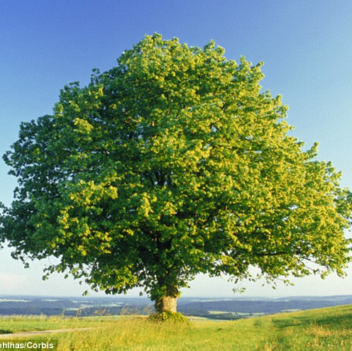
Parents and Carers of Oak Class, Autumn Meeting 2024
Timetable
Topics
Class Agreement
Homework
Swimming

Slide 4
Maths and English
In Maths, we are currently looking at place value to 1,000,000 and Roman Numerals to 1000.
In English, we are studying The Day the Crayons Quit and The Borrowers.
Our class read is the London Eye Mystery

Slide 7
Homework: Due weekly on Fridays
FYI … homework has been set already and is due in on Friday!
Please see the inside of the light green homework cover for homework expectations.
Maths sheet in book (paper).
Practise spellings in book (writing out, drawing icons, covering up, testing with family etc).
6 games on Edshed (online spelling practise).
Ten minutes of TTRS (Times tables rock stars).

Slide 8
Swimming starts on Wednesday next week.

