Slide 1
to Sycamore Class

Slide 2
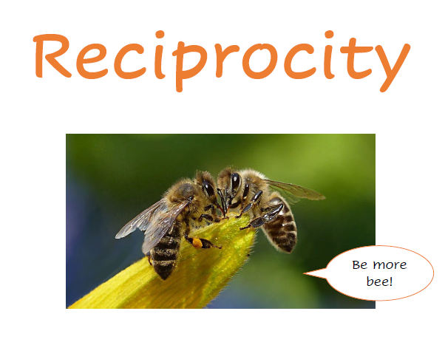
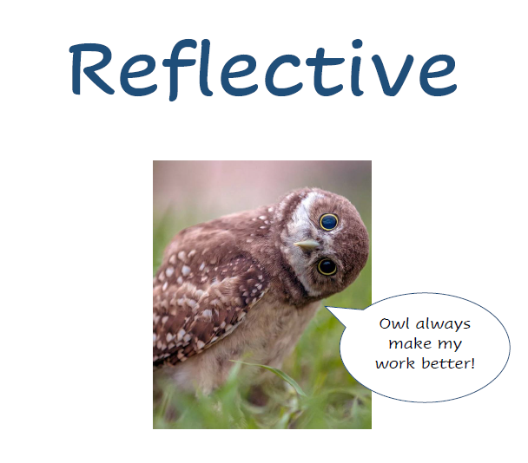
Learning Behaviours
Class agreements based on school values

Slide 3
Staff
Please feel free to come in for a chat at the end of the day or if you have something longer to discuss, pop us an email and we can arrange a time.
Mrs Cleverley
Mr Strick / Mrs Talbot
Ms Mason (TA)
Ms Barlow (PPA)
Mr Tanner (PE)

Slide 4
Rolling programme and topic web

Slide 5
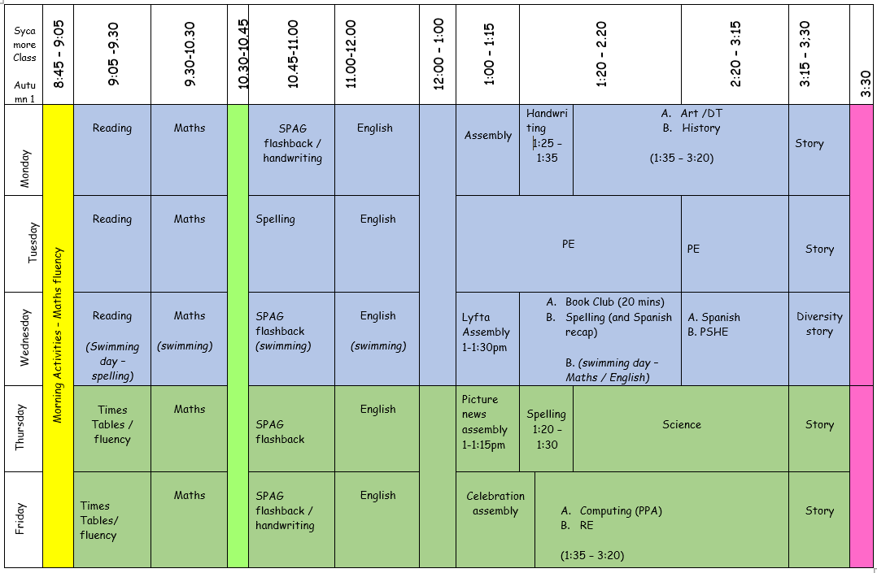

Slide 6
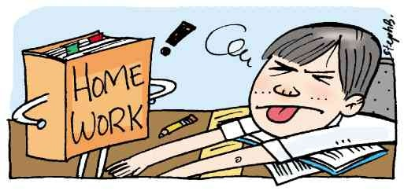
Homework
Homework is set on Friday and due in the following Friday.
Spelling shed (minimum - 3 games) or on paper
TTRS or Numbots (minimum) 10 minutes or on paper
Reading
A piece of maths
PLEASE ENSURE H/W BOOKS ARE IN SCHOOL ON A FRIDAY

Slide 7
Class Trips and Events
Autumn Term
Torquay Museum – The Romans
Printing workshop (in school)
Author visit
Spring Term
Eden project – Rainforest workshop
Summer Term
Overnight camping trip
Outdoor adventure day – paddleboarding / climbing ?

Slide 8
Regular Curriculum Enrichment Activities
PE at Headlands on a Tuesday afternoon (Autumn 1)
Swimming Wednesday mornings for 6 weeks
Forest School – once a half term on a Friday
Trust PE events – football, gymnastics, handball, tennis, mixed activity day, summer sports day.
Eco Committee
School Council
School Choir

Slide 9
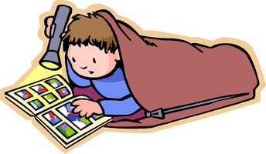
Reading - AR
STAR reading tests – completed 4 times a year in school.
AR reading levels – children need to read within these levels.
Each child has a personalised target to meet by Half Term.
Please listen to your child read as often as possible and encourage them to read daily before or after school.
Reading to your child before bed is hugely beneficial to them!

Slide 10
REWARDS
Informal noticing of progress/ effort/ achievement etc
Thank you notes (for going above and beyond)
Marble jar (class incentive)
Random mini certificates placed inside their exercise book.
Star of the week certificates
Showing work to Miss Barlow
Courtesy cup

Slide 11
Online safety
With the increased access children have to devices that can connect to the internet, it has never been more important to understand how to be safe when using online content.
Whether children are accessing images, online games, social media platforms or just surfing the web, as part of their homework, they need to remain safe.
Online Safety is an important part of keeping children safe at Broadhempston Primary School. We have extensive security measures in place in school, which are monitored both internally and externally, to help safeguard pupils from potential dangers or unsuitable material.
Any online safety incidents are recorded and managed in accordance with our online safety policy and online safety is taught to all pupils as part of our PSHE programme explaining and demonstrating how to stay safe and behave appropriately online. We also regularly post online safety guides on our Facebook page.
You will find some useful information below to help raise awareness of this important subject area.

Slide 12
Online safety
Online safety is taught to all pupils as part of our PSHE and computing schemes of work and we also cover additional topics half termly demonstrating how to stay safe and behave appropriately online.
For parents, we regularly post online safety guides on our Facebook page and these can also be found on our website with lots of other information to help raise awareness of this important subject area.

Slide 13
Any questions?
(and no . . . I don’t expect you to put your hands up!)

